Slide 1

NETS Python Workshop Day 2
February 26th, 2023

Slide 2
Recap on what we have done so far…
Unsupervised ML
04
Dendrogram
Data visualization
03
Matplotlib, seaborn
Data processing
02
Pandas, Numpy
Data structures
01
Data types, conditional statements, loops, and defining functions

Slide 3
Data Structures
Brief overview of the data structures we talked about:
Lists: A collection of elements that can be of different types
Arrays: A collection of elements of the same type
Tuples: Similar to a lists, but elements can not be changed once created
Dictionaries: a collection of key-value pairs.
What is it?
A way of organizing and storing data in a particular format.
Some common data types:
Numbers
Strings
Booleans

Slide 4
Data Processing
Typically includes the following steps:
Data collection: from databases, or experiments
Data cleaning: remove any inconsistent data, and dealing with errors in the data
Data transformation: prepare the data for analysis through data scaling, create new features, etc
Data analysis
Data interpretation
What is it?
Involve converting raw data into meaningful information, in turns making it more manageable and understandable
Python Libraries
Numpy
Pandas
More…

Slide 5
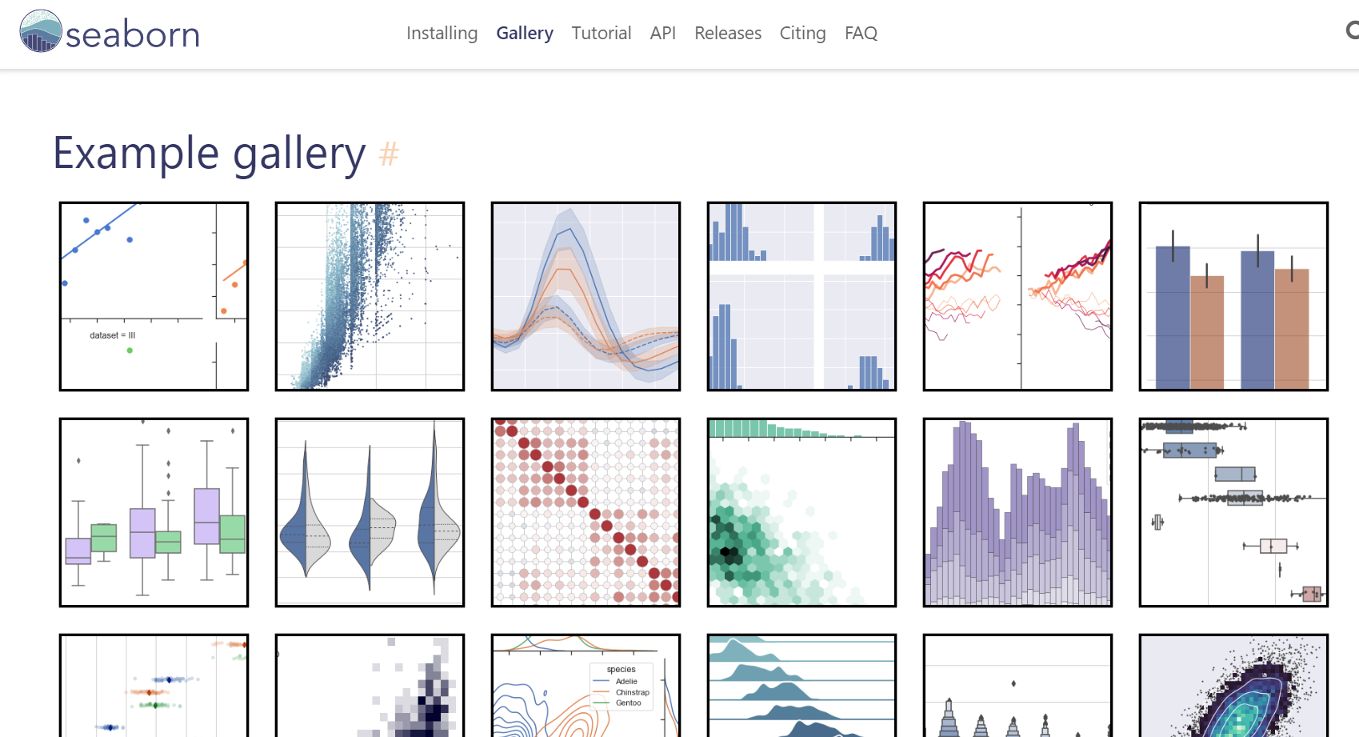
Data Visualization
Python Libraries
Matplotlib
Seaborn
More…

Slide 6
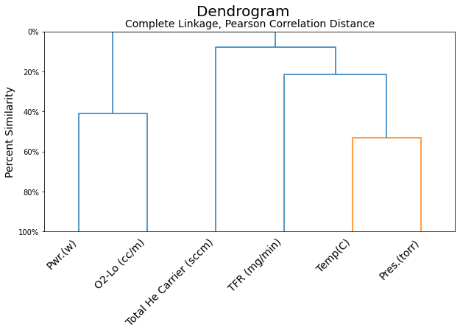
Unsupervised ML - Dendrogram
What is a dendrogram?
A type of diagram to visualize the hierarchical relationship between different variables in a dataset

Slide 7
Today’s Agenda
Web application
04
Supervised ML
03
Intro to APIs
02
File Manipulation
01
Up next

Slide 8
What is Machine Learning?
In short, Machine Learning is…
a subfield within Artificial Intelligence
a method of teaching computers to recognize patterns and make predictions based on existing data
the method of teaching is called an algorithm or a model
Successful AI/ML applications are seen across engineering and research fields
Notes:
High - level abstraction means human readable – low level abstraction means more machine readable – in case anyone asks

Slide 9
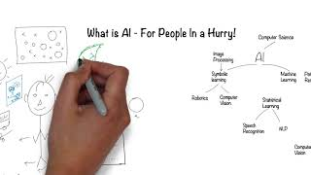

Slide 10
File Manipulation
Open Notebook
File_manipulation.ipynb
Notes:
30 minutes

Slide 11
10 minutes break
Grab a bagel!

Slide 12
Intro to APIs
Open Notebook
Intro_to_Materials_API.ipynb
Notes:
30 minutes

Slide 13
10 minutes break
Grab a bagel!

Slide 14
Supervised Machine Learning
Open Notebook
Supervised_ML.ipynb
Notes:
30 minutes

Slide 15
10 minutes break
Grab a bagel!

Slide 16
Web Application
Open Notebook
web_application.ipynb
Notes:
30 minutes

Slide 17
What we’ve learn today
Web application
04
Supervised ML
03
Intro to APIs
02
File Manipulation
01

Slide 18
Other Resources for YOU
General Python: https://github.com/phillipai/100-days-of-code-python
Material Sciences: https://github.com/materialsvirtuallab/nano281
Physics: https://deeplearningforphysicsresearchbook.github.io/deep-learning-physics/
Overview of ML for Material Science: https://towardsdatascience.com/machine-learning-in-materials-science-8c6c0db5ce7a
Competitions: https://www.kaggle.com/competitions

Slide 19
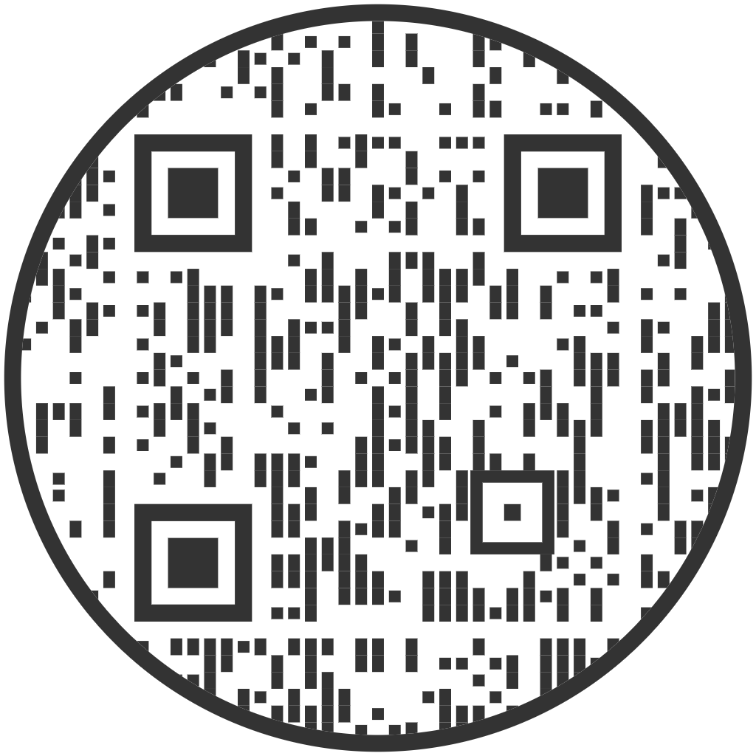
Food and Goodbye.
Thank you everyone for coming!
Sign out here for Assassin points and we’d love to hear your feedback

